Slide 1
Ch.3 Evaluation of Uncertainty in
Time-Domain Spectroscopy
Lee Jong Geon

Slide 2
Contents
Method of Uncertainty Evaluation
Sources of Uncertainty in Terahertz Time-Domain Spectroscopy
Practical Implementation

Slide 3
Method of
Uncertainty Evaluation

Slide 4
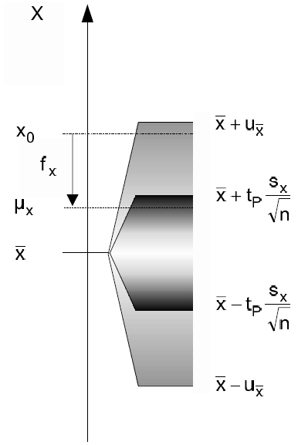
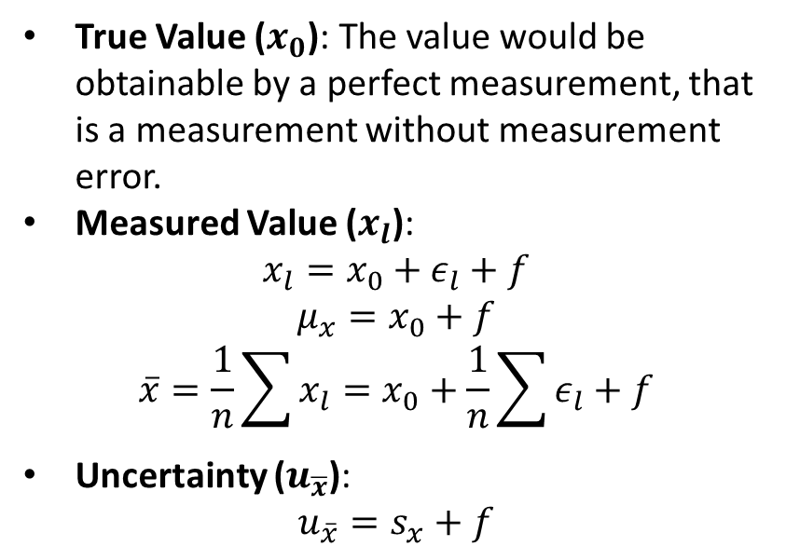
1.1 General Definitions
Type A uncertainty: uncertainty by a statistical analysis of quantity values obtained by measurements under repeatability conditions
Type B uncertainty: uncertainty by means other than a statistical analysis of quantity values obtained by measurement
True Value ($x_{0}$): The value would be obtainable by a perfect measurement, that is a measurement without measurement error.
Measured Value ($x_{l}$):
$$x_{l}=x_{0}+ε_{l}+f$$
$$μ_{x}=x_{0}+f$$
$$\overline{x}=\frac{1}{n}\sum{x_{l}}=x_{0}+\frac{1}{n}\sum{ε_{l}}+f$$
Uncertainty ($u_{\overline{x}}$):
$$u_{\overline{x}}=s_{x}+f$$
International Vocabulary of Basic and General Terms in Metrology (VIM), ISO, 2004.
Grabe, M., Measurement Uncertainties in Science and Technology, New York: Springer, 2005.

Slide 5
1.2 Evaluation of Random and Systematic Errors
Type A uncertainty: Random uncertainties
➔ averaging
Type B uncertainty: Systematic uncertainties
➔ cannot be analyzed with statistics
International Vocabulary of Basic and General Terms in Metrology (VIM), ISO, 2004.
Grabe, M., Measurement Uncertainties in Science and Technology, New York: Springer, 2005.

Slide 6
1.3 Propagation and Combination of Measurement Uncertainty
Type A uncertainty: Random uncertainties
➔ averaging
Type B uncertainty: Systematic uncertainties
➔ cannot be analyzed with statistics
International Vocabulary of Basic and General Terms in Metrology (VIM), ISO, 2004.
Grabe, M., Measurement Uncertainties in Science and Technology, New York: Springer, 2005.

Slide 7
References
International Vocabulary of Basic and General Terms in Metrology (VIM), ISO, 2004.
Grabe, M., Measurement Uncertainties in Science and Technology, New York: Springer, 2005.

